Slide 1
Trends in Global Terrorism
Kristen Hyman
Yassine Slimani
Mohammad Shams
Randolf Fonkwo

Slide 2

Motivation and Summary
Recent news coverage leads many to believe that global terrorism is on the rise.
Within this presentation, our group will assess data collected over the last six years to discover the true trends in global terrorism.

Slide 3
Questions
Our group was interested in analyzing global terrorism trends over the last six years (2012-2017) to answer questions on world-wide and region-specific trends in terrorism:
Is terrorism on the rise? Are the majority of attacks successful?
What are the most common types of terror attacks attempted over the time period reviewed?
Does terrorism increase during any specific time of the year?
How does terrorism in the Middle East compare to the rest of the world?

Slide 4
Data Source

Slide 5
Data Source – Initial Struggles
The team initially experienced some difficulties in finding appropriate data sets to utilize.
Much of the data available was incomplete, included outdated or unreliable information, or required a subscription.

Slide 6


Data Source Utilized
The data analyzed in this presentation was obtained from the National Consortium for the Study of Terrorism and Responses to Terrorism (START) Global Terrorism Database (GTD).
The GTD is a detailed, current, reliable, and open source dataset, with valid data collection methodolgy and sources.

Slide 7
GTD Parameters and Definitions
It was important for the team to understand the landscape of the data set before beginning analysis.
GTD Definition of Terrorism:
The threatened or actual use of illegal force and violence by a non-state actor to attain a political, economic, religious, or social goal through fear, coercion, or intimidation.
The GTD does not include plots or conspiracies that are not enacted, or at least attempted.
The GTD does include attacks that were attempted but ultimately unsuccessful.

Slide 8
Data Analysis

Slide 9
Worldwide Terrorism Trends

Slide 10
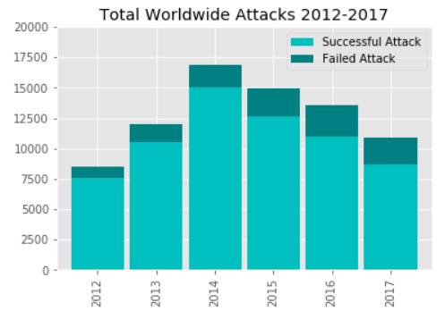
Worldwide Terrorism Trends
Is terrorism on the rise? Are the majority of attacks successful?
Global Terrorism has been on the decline for the past four years.
In the past six years, 2014 had the highest number of total attacks.
The majority of attacks are successful.

Slide 11
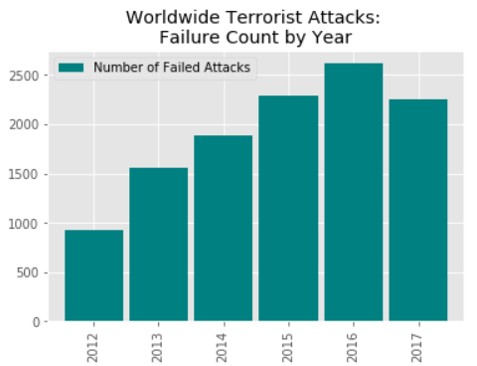
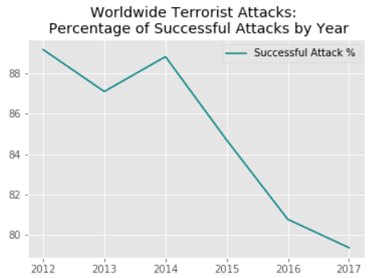
Worldwide Terrorism Trends
Is terrorism on the rise? Are the majority of attacks successful?
Since 2014, terrorist attacks have become less successful.

Slide 12
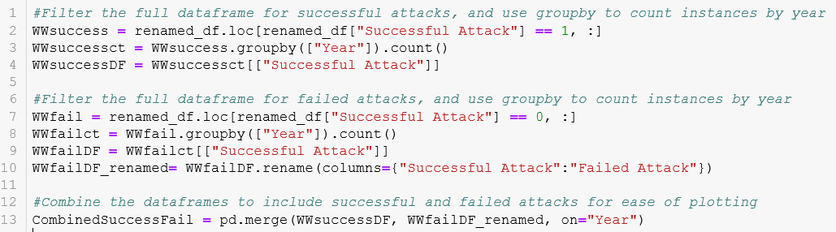
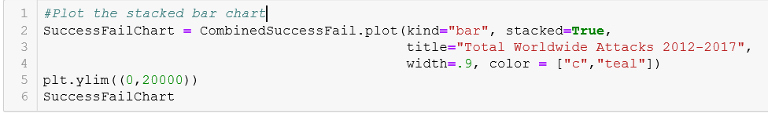
Worldwide Terrorism Trends
Portion of code used for analysis:

Slide 13
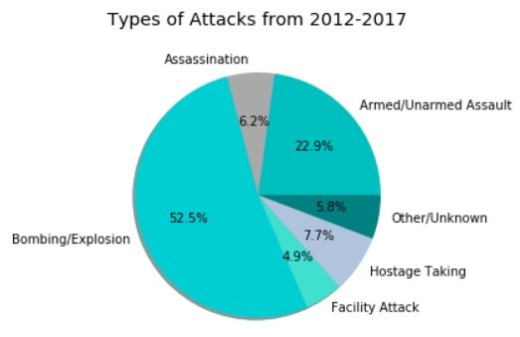
Worldwide Terrorism Trends: Types of Attacks
What are the most common types of terror attacks attempted over the time period reviewed?
The team initially expected armed/unarmed assault to be the most common type of attack based on news coverage.
However, Bombings/Explosions have been the most common type of terrorist attack over the past six years.
After reviewing the scope of the data set and excluding biases, these results do appear reasonable.

Slide 14

Worldwide Terrorism Trends: Types of Attacks
Portion of code used for analysis:
Original Attack Types:
Assassination
Bombing/Explosion
Hijacking
Hostage Taking (Barricade Incident)
Hostage Taking (Kidnapping)
Facility/Infrastructure Attack
Armed Assault
Unarmed Assault
Unknown
Updated Attack Types:
Assassination
Bombing/Explosion
Hostage Taking
Facility/Infrastructure Attack
Armed/Unarmed Assault
Other/Unknown

Slide 15
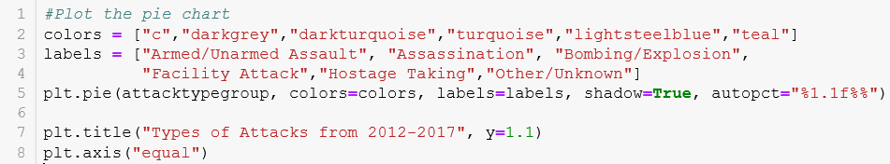
Worldwide Terrorism Trends: Types of Attacks
Portion of code used for analysis:

Slide 16
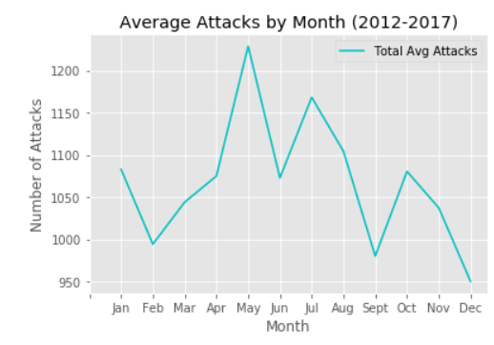
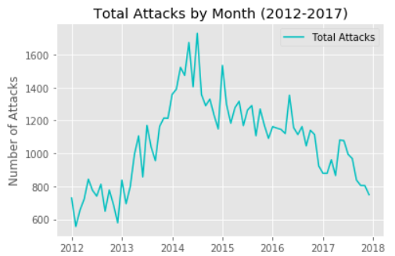
Seasonality of Attacks
Does terrorism increase during any specific time of the year?
Terrorism does appear to fluctuate with the time of year. Terrorist attacks are highest in the Spring/Summer months.
There are spikes in activity throughout the seasons: Spike in January(winter), May(spring), July(summer), and October(fall).

Slide 17
Terrorism in the Middle East

Slide 18
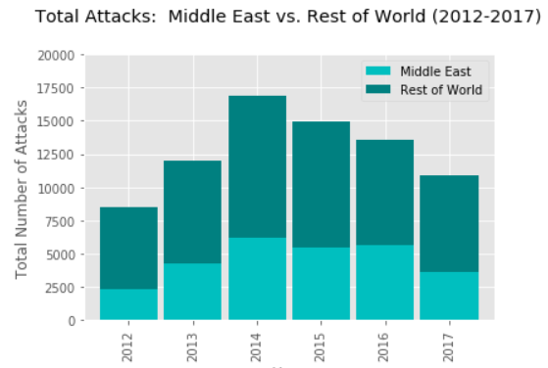
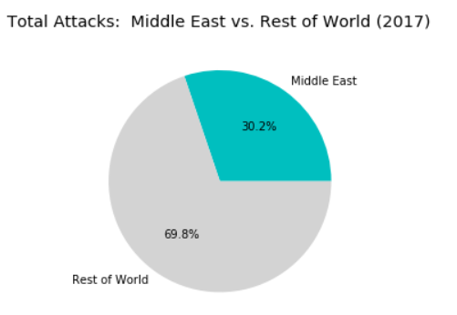
Terrorism in the Middle East
How does terrorism in the Middle East compare to the rest of the world?
A significant portion of all worldwide terrorist attacks occur in the Middle East, which is in line with expectations based on news coverage.
In 2017, almost one-third of all terrorist attacks occurred in the Middle East. This is interesting, as less than 5% of the world lives in this region.

Slide 19
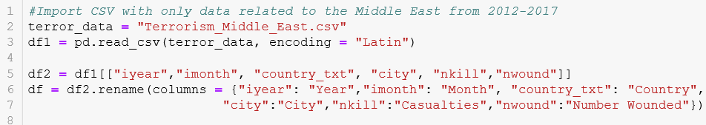
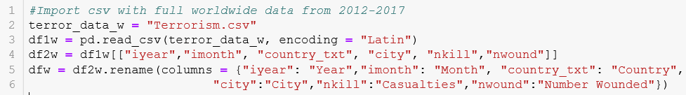
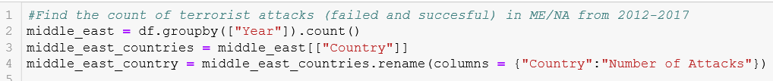
Terrorism in the Middle East
Portion of code used for analysis:

Slide 20

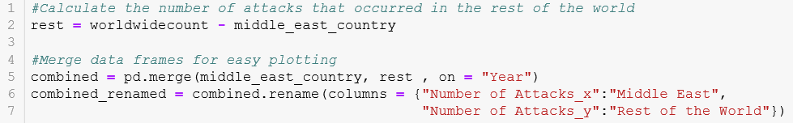
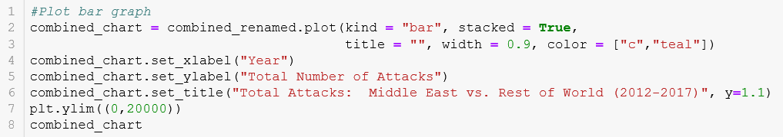
Terrorism in the Middle East
Portion of code used for analysis:

Slide 21
Summary and Future Research

Slide 22
Summary and Future Research
Based on news coverage, our group was surprised to find that the rate of terrorist attacks is decreasing, and that terrorist attacks are becoming less successful.
We were also initially surprised that armed attack(gun violence) was not the leading type of attack, however, upon further analysis of the data set and definition of terrorism, this does appear reasonable.
We were not surprised to find that a significant portion of all worldwide terrorist attacks occur in the Middle East, as this is in line with expectations based on news coverage.
We could consider performing future research on what drives the seasonality of terrorist attacks, and what is impacting the rate of success of attacks (i.e., increased surveillance, improving technology, etc.)

Slide 23
Questions?

Slide 24
Citations
National Consortium for the Study of Terrorism and Responses to Terrorism (START). (2018). Global Terrorism Database [Data file]. Retrieved from https://www.start.umd.edu/gtd

